Slide 1
Fun with Numbers
Learning basic math concepts through fun activities.

Slide 2
Lesson Objectives
Mathematics for Year 1
Introduce the presentation on Mathematics for Year 1 students
Lesson Objectives
By the end of this lesson, you will:
Recognize numbers 1-20
Count objects up to 20
Add and Subtract within 10
Identify basic shapes
Understand simple patterns

Slide 3
Vocabulary
Number | A symbol or word that represents a quantity.
Addition | The process of finding the total or sum by combining two or more numbers.
Subtraction | The process of finding the difference by taking one number away from another.

Slide 4
Number & Algebra
In Year 1, we learn:
Counting and recognizing numbers
Simple addition and subtraction
Understanding patterns
Basic shapes and objects
Grouping and sharing equally
Let's make math fun and easy!

Slide 5
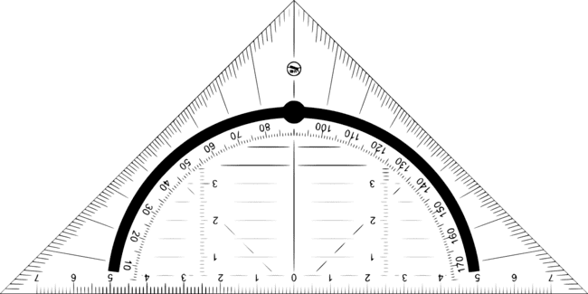
Measurement & Geometry
Measurement and Geometry help us understand shapes and sizes.
We learn about:
Length: How long or short something is.
Height: How tall or short something is.
Shapes: Circles, squares, triangles, and more.
Position: Where things are placed.
Have fun exploring!

Slide 6
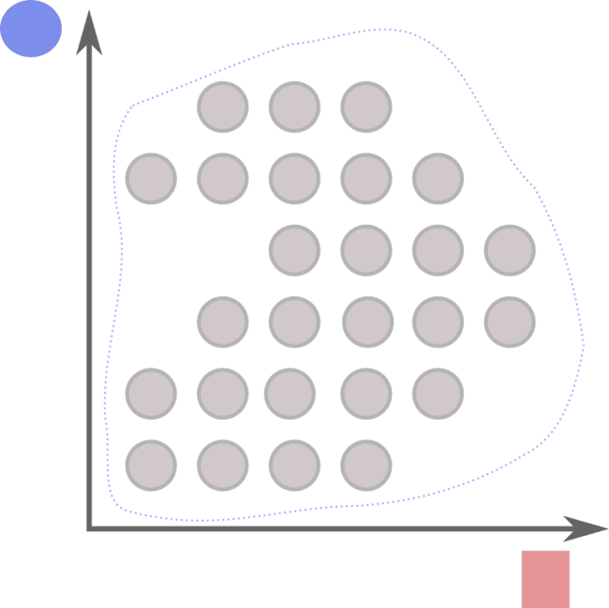
Statistics & Probability
Statistics and Probability
We learn to collect data.
We count and sort objects.
We use charts to show information.
We predict outcomes (what might happen next).
We talk about what is likely or unlikely.
Example: How many apples are red?

Slide 8
Counting Forwards
Let's count forwards from 1 to 10!
Start at 1.
What comes next?
Continue counting until you reach 10.
Can you do it?

Slide 9
Counting Forwards
Start at 1.
Next is 2.
Then comes 3.
After 3 is 4.
Next is 5.
Then comes 6.
After 6 is 7.
Next is 8.
Then comes 9.
Finally, 10!
Great job!

Slide 10
Counting Forwards
We start at the number 1 and continue to the next number.
Counting forwards means moving from a smaller number to a bigger number.
Each number comes right after the previous one.
Practice will help you remember the order of numbers!

Slide 11
Counting Backwards
Let's count backwards from 10 to 1!
Start at 10
Count backwards step-by-step until you reach 1
What numbers do you say?

Slide 12
Counting Backwards
Here's how we count backwards from 10 to 1:
10
9
8
7
6
5
4
3
2
1

Slide 13
Counting Backwards
We use counting backwards to:
Start at 10 and move one number down to 9
Continue this until we reach 1
This helps us understand the order of numbers and improves our counting skills!

Slide 14
Number Line
Locate the number 3 on the number line below:
0 1 2 3 4 5

Slide 15
Number Line
Start at 0.
Move 1 step to the right to reach 1.
Move 1 more step to the right to reach 2.
Move 1 more step to the right to reach 3.
3 is located here!

Slide 16
Number Line
We start at 0 on the number line.
We move step by step to the right.
Each step represents moving from one number to the next.
We stop moving when we reach the number 3.
This shows how to find numbers on a number line.

Slide 17
Days of the Week
Days of the Week
Monday
Tuesday
Wednesday
Thursday
Friday
Saturday
Sunday
Each day is special and important!
Remember: We have 7 days in a week!

Slide 18
Using Materials
Imagine you have 5 apples and you get 3 more apples from a friend.
How many apples do you have now?

Slide 19
Using Materials
Step 1: Start with 5 apples.
Step 2: Add 3 more apples to the 5 apples you already have.
Step 3: Count all the apples together: 5 + 3.
Answer: You have 8 apples now.

Slide 20
Using Materials
We start with 5 apples, which is our initial number.
Next, we add 3 more apples to this number.
Finally, we count all the apples to find the total. This helps us understand addition by using real objects.

Slide 21
Giving Directions
Emma needs to find the school library. Here are her steps:
Start at the main entrance.
Walk straight for 10 steps.
Turn left and walk 5 steps.
Turn right and walk 3 steps.
Where is the library?

Slide 22
Giving Directions
Start at the main entrance.
Walk straight for 10 steps. You arrive at the hallway intersection.
Turn left and walk 5 steps. You are now near the classrooms.
Turn right and walk 3 steps. You arrive at the school library's door.
The library is at the end of the hallway, on the right side.

Slide 23
Giving Directions
Use directions to find places.
Walk straight and count steps.
Turn left or right when instructed.
Follow each step carefully to reach the final destination. This example shows how to use simple steps to find a place in school.

Slide 24
Counting Sequences
Start at 2 and count by 2s until you reach 10.
What numbers do you say?

Slide 25
Counting Sequences
Start at 2
Add 2 each time:
2
4
6
8
10

Slide 26
Counting Sequences
We start at 2 because the problem asks us to.
We add 2 each time because we are counting by 2s.
We stop at 10 because the problem asks us to reach 10.

Slide 27
Data Representation
Look at the picture below:
!
How many of each fruit are there?
Show the data in a table.

Slide 28
Data Representation
Let's count the fruits:
Apples: 5
Bananas: 3
Oranges: 4
Here is the table:
| Fruit | Number |
|---------|--------|
| Apples | 5 |
| Bananas | 3 |
| Oranges | 4 |

Slide 29
Data Representation
I start by counting each type of fruit in the picture.
Then, I list the number of each fruit.
Finally, I organize the data into a table to make it clear and easy to understand.

Slide 30
Comparing Lengths
Direct Comparisons:
Place objects side by side
See which is longer or shorter
Indirect Comparisons:
Use uniform informal units (e.g., paperclips)
Measure each object with the same units
Compare the number of units used

Slide 31
Explaining Patterns
Look at the pattern:
🟦🟦🟩🟩🟥🟥🟦🟦
What comes next?
Options:
🟦🟦
🟩🟩
🟥🟥

Slide 32
Explaining Patterns
Let's solve it step-by-step:
Identify the repeating sequence: 🟦🟦🟩🟩🟥🟥
Notice that the pattern repeats every 6 shapes.
After 🟥🟥, the pattern starts over with 🟦🟦.
So, the next shapes are: 🟦🟦

Slide 33
Explaining Patterns
To solve this pattern problem:
Identify the repeating sequence.
Count the number of shapes in the sequence.
Determine what comes next by following the sequence.
We see the pattern repeats every 6 shapes, so the next shapes are 🟦🟦.

Slide 34
Partitioning Numbers
How can we partition the number 10 in different ways?
Example 1: 10 = ? + ?
Example 2: 10 = ? + ? + ?

Slide 35
Partitioning Numbers
Example 1: 10 = 7 + 3
Example 2: 10 = 5 + 2 + 3

Slide 36
Partitioning Numbers
We start with the number 10.
We break it into parts: 7 and 3 for Example 1.
We use 3 parts: 5, 2, and 3 for Example 2.
This shows different ways to make 10 by adding smaller numbers.

Slide 37
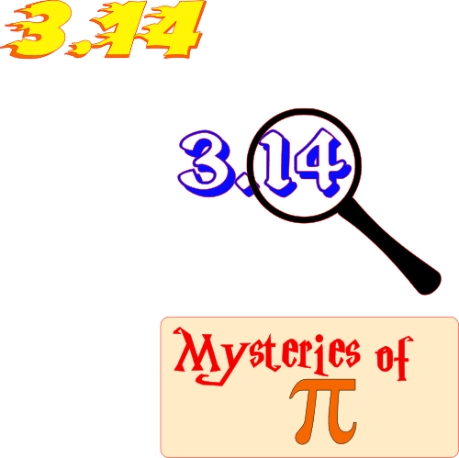
Summary of Lesson
Key Points of Year 1 Math Lesson
Numbers: Counting from 1 to 20
Shapes: Recognizing circles, squares, and triangles
Addition: Simple sums up to 10
Subtraction: Simple subtractions within 10
Patterns: Identifying simple patterns
Well done, young mathematicians!

